Slide 1
Managing Complex and Contentious Claims
Fire Claims: So you think they’re simple?
22nd March 2017
John T. Kidd Michael van Bergen
John Kidd Loss Adjusters LLC Marsh Dubai
Notes:
Thank you for opportunity to speak about claims
My experience
Workshop, interactive, ask questions at anytime

Slide 2
Key Roles in the Claims Process

Slide 3
Reinsurance participants and their roles
Insured
  The person or entity protected under a contract of insurance
Broker
  A specialist in handling insurance business
Insurer / Reinsurer
  Accepts the risk which the insured has decided to transfer
  Undertakes to indemnify for losses
Loss Adjuster
  Instructed on behalf of insurers, but remains impartial
  Presents the facts
  Engages independent engineers & Forensic Accountants
Notes:
2
Broker
Our Loyalty is to the Insured
Risk engineering
Risk Transfer Advisor and insurance marketing
Placement and claims
Most importantly…Intermediary within the Insurance Market
- Understand how the market works / use relations
- Work with Loss Adjusters and Insurers to achieve the best and correct results
Insurer –
The insurance company that…
Accept notification and appoint appropriate expertise
Be the focal point for the Insured / broker and following market
Accurate reserving
Establish validity of the claim (coverage)
Lead negotiations
Pay valid claims
N.B Reinsurers may also purchase their own reinsurance…
Adjuster -
Impartial / present on the facts
Influence their instruction
Key contact and controlling influence in the claims process.
Independent Engineers -
Civil, mechanical, material failure experts, chemical etc
Used for both RCA analysis and quantum evaluation

Slide 4
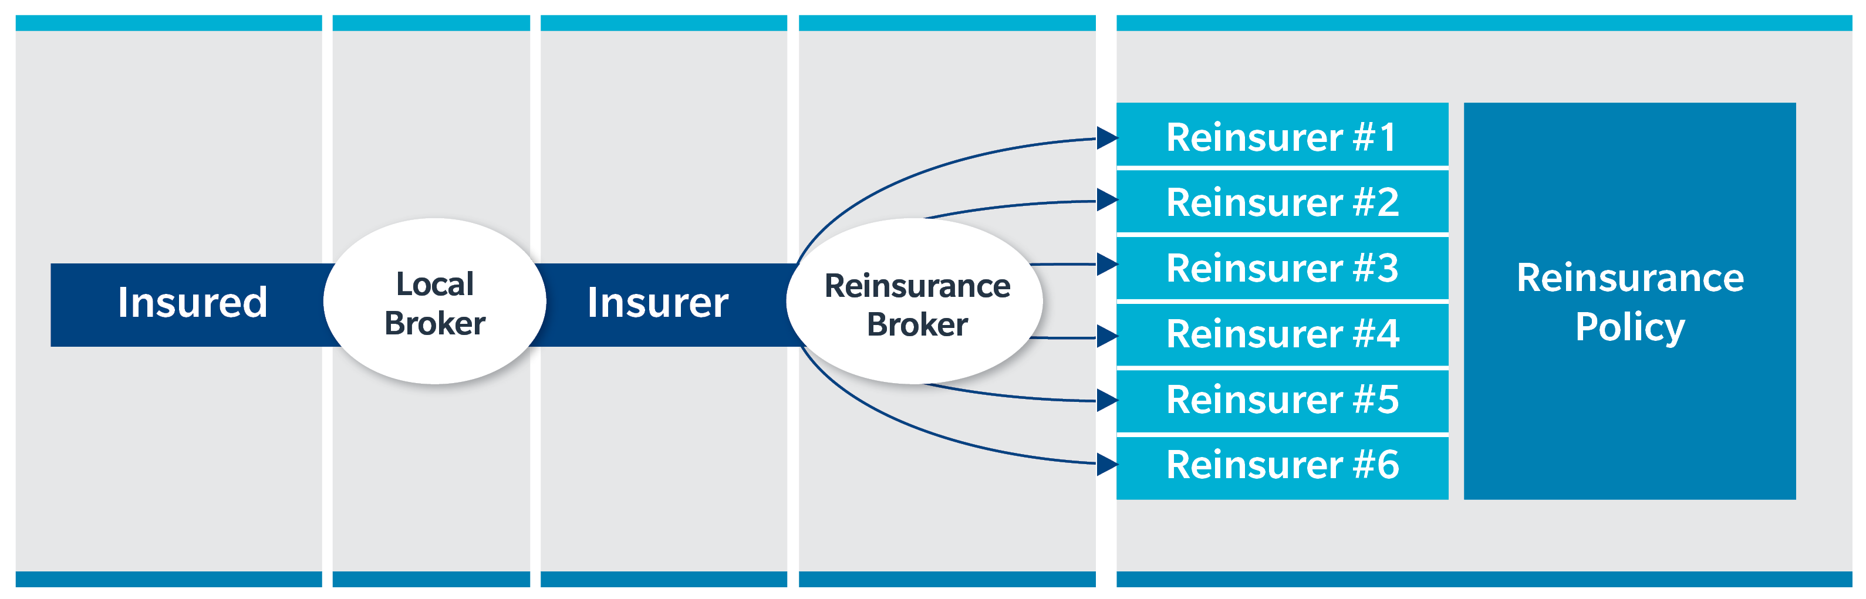
The Contract Flow
Premium Funds
Claims Payments

Slide 5
The Claims Consultancy Process

Slide 6

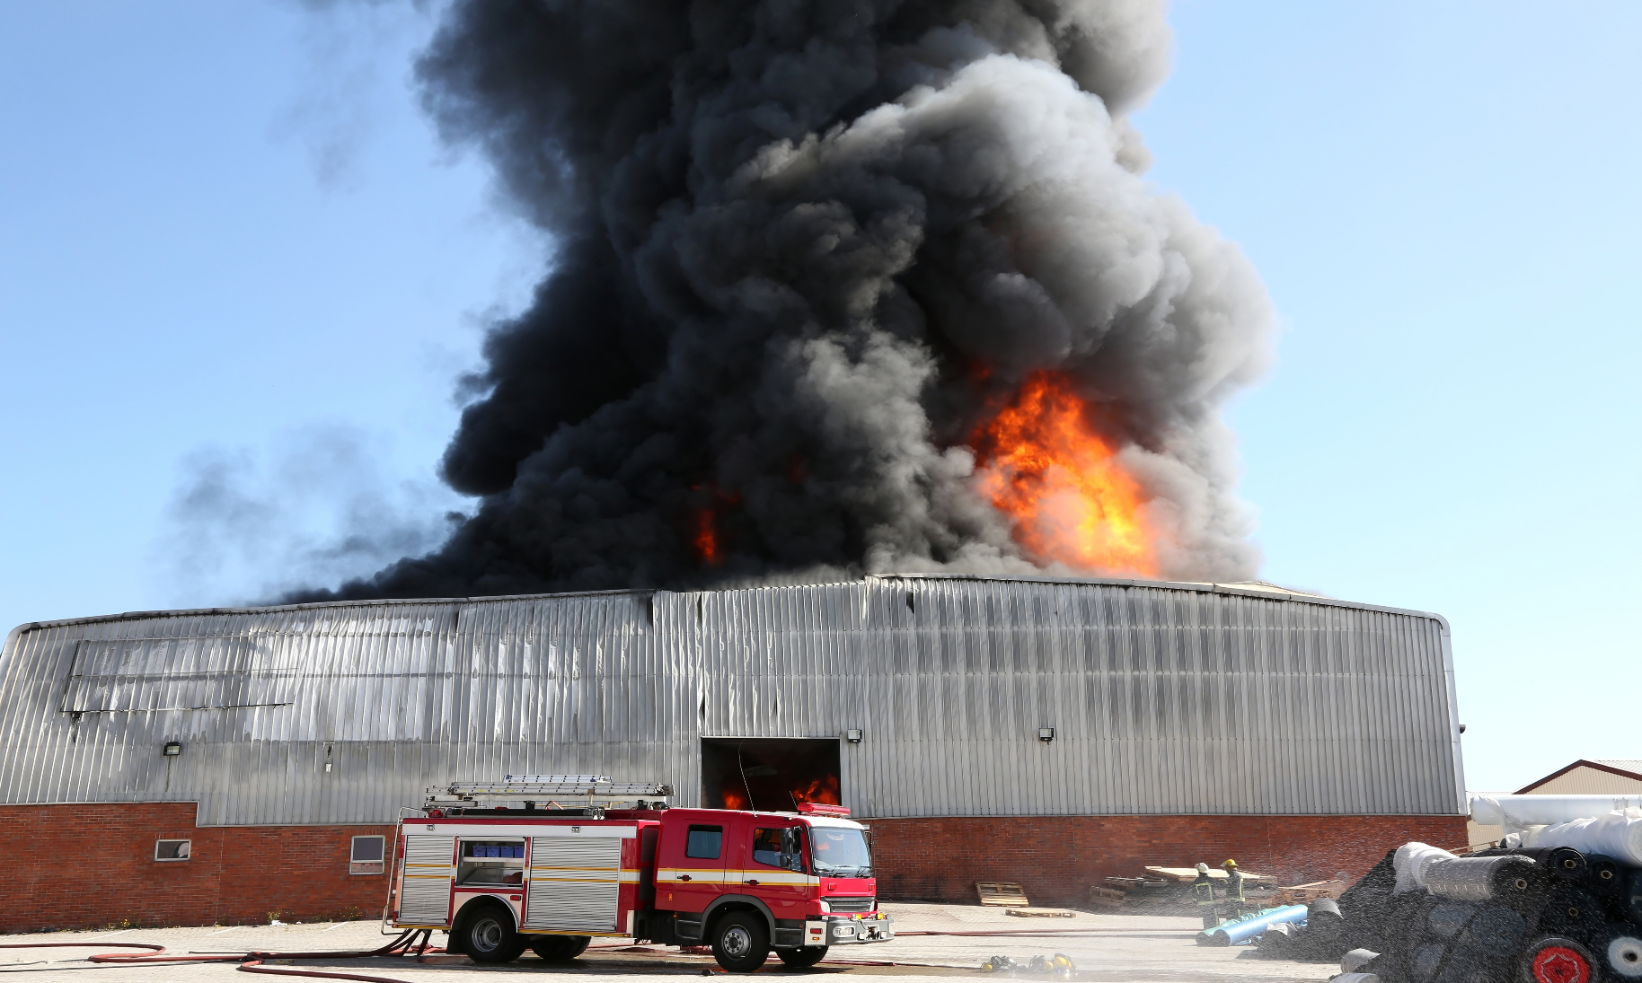

Fire can be Dramatic

Slide 7
Insured Business
Today’s workshop is based on an actual fire and associated business interruption loss which occurred in the UAE in March 2016.
The Insured business was a department store/ foodstuffs operation located in a 3 storey building of standard construction.
The permanent fire fighting facilities included sprinklers and hose reels. The fire pump room was located in the basement. The usual mix of hand held fire extinguishers were present in the Insured’s premises.
The building was owned by a commercial landlord who did not occupy any part of the premises.

Slide 8
Insured Business
The principal tenant was the Insured who occupied: 75% of 1st floor as a department store
60% of ground floor as a supermarket
100% of basement dry/ bulk store.
The remaining areas were occupied by various tenants as independent shops and restaurants on the ground and first floors.
The risk was surveyed by Insurers prior to acceptance of the risk.

Slide 9
Preparation & Prevention
Understand the clients business, client training & wording analysis
Notification and Acknowledgement
Important to start on the right foot - set the tone
for the way the claim will proceed
Attention to the notification clause:
“Claims likely to exceed the policy deductibles shall be notified as soon as practicable but within 30 days after the occurrence…”
If in doubt, notify the loss
Notes:
Practicable – important to recognise the first priority in not insurance. Get plant safe first.
If notification is late, it is more often the case that the claim did not manifest itself / become apparent for some time or the client did not realise they could claim.

Slide 10
Question
1
What would be some of the most common reasons for late notification?
The cause did not become apparent until failure manifestation
The Insured was not aware of the coverage purchased
The Insured waits to see if the deductible is breached
IF IN DOUBT, NOTIFY!
Notes:
OK, lets get the audience warmed up for the scenario, with the first question…

Slide 11
Question
2
What are the possible impacts of late notification?
Insurers experts are delayed in commencing their investigation
Insured continues with clean up and repair
Insurers denying liability if position is prejudiced
Notes:
Prudent uninsured

Slide 12
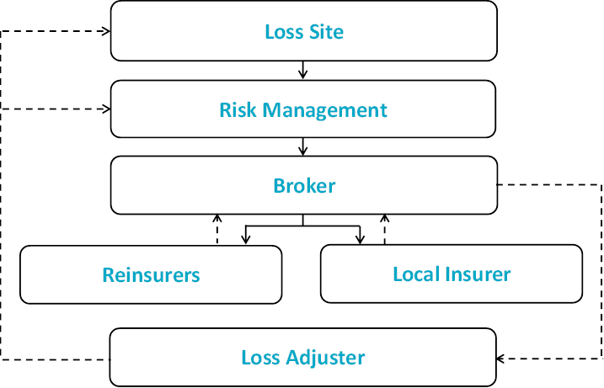
Claims Notification Flow Chart
Notes:
Marsh assess coverage:
- Not every loss will result in a claim – must fall within terms and conditions of the policy.
- We will look at how / if the policy has been triggered
- Any applicable conditions, warranties or exclusions
- What deductible(s) should apply
Liaise with insured re claims strategy:
- How are we going to proceed? / What are the next steps?
- Any problems or issues to be resolved?
- Indentify individual action points
- Time scales
Adjuster instruction - claims control / co-operation

Slide 13
The Claim Scenario
A fortuitous fire occurred shortly before close of business late one evening.
1st floor completely burnt out – stocks and FF&F – total loss. There was serious damage to the roof and some structural elements of the building.
Ground floor damaged/ soiled – stocks – total loss with salvage; FF&F – partial damage.
Basement extinguishing water ingress - stocks – partial damage due to wetting and collapse of stacks.

Slide 14
The Claim Scenario
Trading ceased; the business was closed until full reinstatement
Closure – originally estimated at 9 months, extended to more than 12

Slide 15
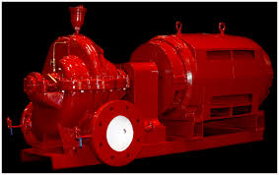
Insured Business
Offices
(10%)
Department Store
(65%)
Super Market
(65%)
Basement dry goods store
(100%)

Slide 16
Preparation & Prevention
Understand the clients business, client training, wording analysis, claims protocol, provide claims data, case studies
Notification and Acknowledgement
Important to start on the right foot - set the tone
for the way the claim will proceed
Coverage
Has the policy been triggered?
Coverage:
- 1st Stage to manage expectations
- Sub limits – ROD, Expediting Expenses, Schedule B values etc
- Exclusions
Notes:
Note sub limits
Opportunity to manage expectations
Marsh assess coverage:
- Not every loss will result in a claim – must fall within terms and conditions of the policy.
- We will look at how / if the policy has been triggered
- Any applicable conditions, warranties or exclusions
- What deductible(s) should apply

Slide 17
The Insured’s Policy
The Insured held a standard fire and perils policy covering :-
Furniture fixtures and fittings - Sum Insured US$ 2 million
Stocks - Sum Insured US$ 2 million
Gross profit – 12 months indemnity period - Sum Insured US$ 3 million
Total sum insured USD 7,000,000.
Policy coverage was on reinstatement basis and included removal of debris and professional fees extensions.
It is presumed but not known if the building was insured by the owner.

Slide 18
Question
3
Would you expect the policy to have been subject to average?
Yes it was!
As it happens there was no underinsurance.

Slide 19
Question
4
Would you expect the Policy to have been subject to any warranties?
What warranties might you expect?
Hazardous goods warranty
Insured premises to be maintained in very good condition and proper housekeeping to be followed at all times
All fire-fighting equipment to be maintained in full working condition
The Insured to comply with Civil Defence regulations regarding fire safety and fire-fighting equipment and hold valid Civil Defence certifications

Slide 20
Preparation & Prevention
Understand the clients business, client training, wording analysis, claims protocol, provide claims data, case studies
Notification and Acknowledgement
Important to start on the right foot - set the tone
for the way the claim will proceed
Insurers experts investigate & engage with Insurers
  Damage
  Root Cause
  Costs
Establish coverage early
  Pursue interim payments
Communication with all parties
  Talk about the issues
  Never all black and white
Coverage
Has the policy been triggered?
Claim Strategy
Plan of action
Insurer Contact
Communicate loss to insurers
Information Gathering and Analysis
Prove your claim!
Notes:
Claim Strategy – Different reinstatement options – scrap one site (100m) and beef up another (75m)
Insurer contact – No of CAP’s??
Liaise with insured re claims strategy:
- How are we going to proceed? / What are the next steps?
- Any problems or issues to be resolved?
- Indentify individual action points
- Time scales
Adjuster instruction - claims control / co-operation

Slide 21
Operative Clause Trigger
The policy is in force. The premium was paid.
The Insured’s property is covered.
The Operative Clause is triggered.
The scenario is not untypical. The case looks straightforward.

Slide 22
Question
5
What possible problems could arise? Any ideas?
1. Conflicting cause Reports:
Police say electrical fire in the Insured’s equipment;
Independent cause and origin expert says fire originated in another tenants’ shop
2. Sprinklers / Hose Reels did not operate. Breach of warranties
3. Extent of damage in basement.

Slide 23
Discussion on Cause
On the one hand the Insured is responsible.
On the other hand another tenant is responsible.
Owner declined to take responsibility to repair the building damage. .
Impact - Closure period prolongation.
- Deterioration of conditions in basement
- TPPD claims against the Insured.

Slide 24
Discussion on Fire Fighting Equipment Failure
Who is responsible Landlord or tenant ?
Was there a maintenance contract ? Who held it?
Who had access to the fire pump room?
Was there a breach of warranties in fact? Manifestly so.
What does it do to coverage ?
Is there a solution for the Insured?
No Control Clause

Slide 25
Discussion re Extent of Damage in Basement
There was no fire in the basement. It was flooded through the stairwell with extinguishing water.
The bottom layers of cartons were wetted and some stacks collapsed causing damage/breakage. That damage was assessed and surveyed. It was around 20% of the total value in the basement.
The remainder of the goods were the subject of contention/negotiation.

Slide 26
Claim Procedures
Notification and Acknowledgement
For more complex claims / areas of grey in the policy
Single point of contact with authority
Mediation
Satisfactory Settlement
Coverage
Claim Strategy
Insurer Contact
Information Gathering and Analysis
Negotiation
Notes:
Negotiation – Single point of contact at Insurers (who has authority and makes decisions)
We are often the mediator – aim is a settlement satisfactory to both parties

Slide 27
Claim Procedures
Notification and Acknowledgement
After successful negotiation, the collection of funds from insurers will commence
Signed proof of loss required?
  Part of the negotiation stage
Collection procedure and time frame established
  30 days
Communicate
Coverage
Claim Strategy
Insurer Contact
Information Gathering and Analysis
Negotiation
Settlement
Notes:
Collection where we get pressure
Realistic ETA’s

Slide 28
Claim Procedures
Notification and Acknowledgement
Claim does not always end at settlement; insurers may decide to subrogate to recover funds from third parties responsible for loss.
Process can take many years
Broker will stay involved and protect client interests
Coverage
Claim Strategy
Insurer Contact
Information Gathering and Analysis
Negotiation
Settlement
Subrogation Management

Slide 29
Preparation & Prevention
Understand the clients business, client training, wording analysis, claims protocol, provide claims data, case studies
Notification and Acknowledgement
Important to start on the right foot - set the tone
for the way the claim will proceed
Coverage
Has the policy been triggered?
Claim Strategy
Plan of action
Insurer Contact
Communicate loss to insurers
Information Gathering and Analysis
Prove your claim!
Negotiation
What is the desired outcome?
Settlement
Collection of funds
Subrogation Management
Are the clients rights being protected?
Post Loss Analysis
Lessons learnt, feedback to placing team, training opportunity for colleagues

Slide 30
